Slide 1
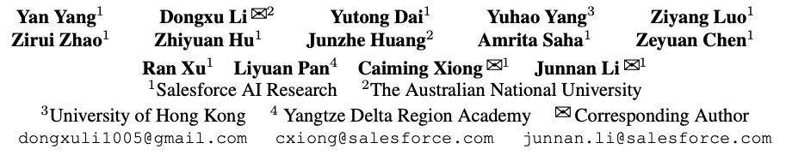
1/13
GTA1: GUI TEST-TIME SCALING AGENT
ICLR 2026
Source: Yang et al., GTA1: GUI Test-Time Scaling Agent, ICLR 2026
Notes:
Smarter choice + more aligned clicking

Slide 2
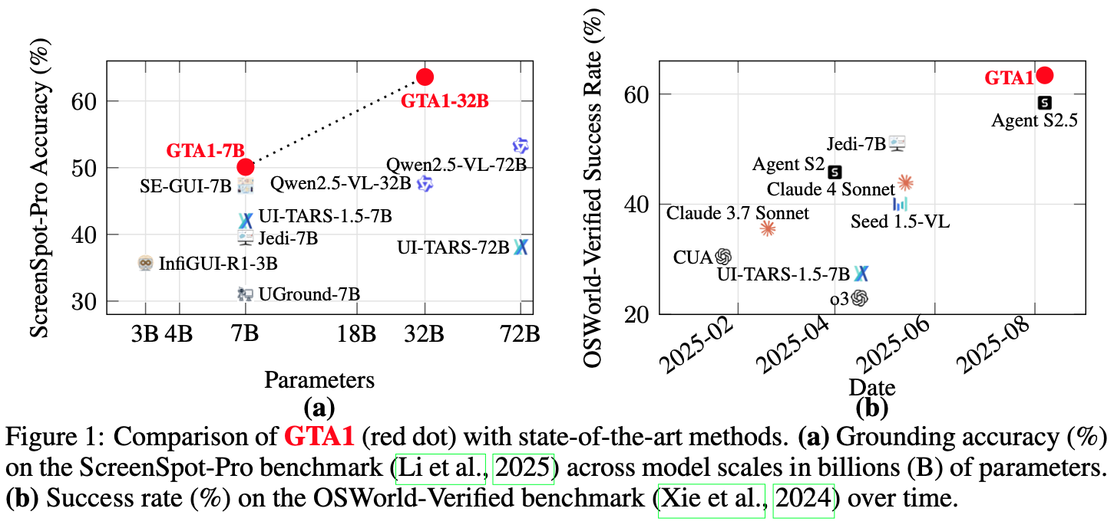
1/13
GTA1
GUI Test-Time Scaling Agent
Can a GUI agent trade inference compute for more reliable computer use?
GTA1 answers yes:
sample several next actions, judge them, then ground the chosen action precisely.
Planning uncertainty
Grounding precision
Task success
Source: Yang et al., GTA1: GUI Test-Time Scaling Agent, ICLR 2026
Notes:
Core question: can we spend more inference compute to make GUI agents more reliable?
GTA1’s answer is local test-time scaling: sample multiple next-action candidates, judge them, then execute one.
The key idea is not a larger agent; it is a more careful decision loop plus precise grounding.
Transition: first explain why GUI control is difficult.

Slide 3
GTA1 - GUI Test-Time Scaling Agent
2/13
Why are GUI agents hard to make reliable?
They must choose the right next step in a huge action space and click the right pixels on changing screens.
User task
➜
Many possible plans
➜
No safe lookahead
➜
Precise UI click
Planning: multiple valid action sequences may exist, but early mistakes cascade.
Environment: real GUI actions can be irreversible, so full rollout lookahead is impractical.
Grounding: high-resolution professional interfaces require accurate coordinates.
Core tension:
robust decisions require more exploration, but GUI execution is step-by-step.
Source: Yang et al., GTA1: GUI Test-Time Scaling Agent, ICLR 2026
Notes:
Early mistakes transfer in the cascade, step-by-step, so crush
Full rollout impractical -> cannot try first and then step backwards
Explain the two bottlenecks: planning uncertainty and pixel-level grounding precision.
Planning is hard because many action sequences can look reasonable, but one early wrong step can break the whole task.
Full rollout is hard in real GUIs because actions may be slow, irreversible, or change external state.
Grounding is hard because professional interfaces require accurate clicks, not just approximate labels.
Transition: previous methods usually improve only part of this pipeline.

Slide 4
GTA1 - GUI Test-Time Scaling Agent
3/13
Where do earlier GUI approaches leave room for improvement?
SFT grounding overfits to element centers, while end-to-end native agents are powerful but hard to inspect.
SFT grounding
Two-stage agents
Native/end-to-end agents
Optimizes exact center points even though any coordinate inside the target element works.
Separates planner and grounding model; easier to improve each module independently.
Completes tasks end-to-end with perception, memory, planning, and action in one agent.
GTA1 keeps the modular two-stage form, then strengthens both weak links: planning selection and coordinate grounding.
Source: Yang et al., GTA1: GUI Test-Time Scaling Agent, ICLR 2026
Notes:
Traditional SFT grounding -> map actions to element center
SFT: supervised fine-tuning trains models to predict the exact center of target interface elements.
Compare three families quickly: SFT grounding, modular two-stage agents, and native end-to-end agents.
SFT grounding often learns element centers, but in real GUI use any point inside the element can succeed.
End-to-end agents are powerful but harder to inspect and improve module by module.
GTA1 keeps the modular structure because it can improve planning selection and coordinate grounding separately.
Transition: now show the actual GTA1 loop.

Slide 5
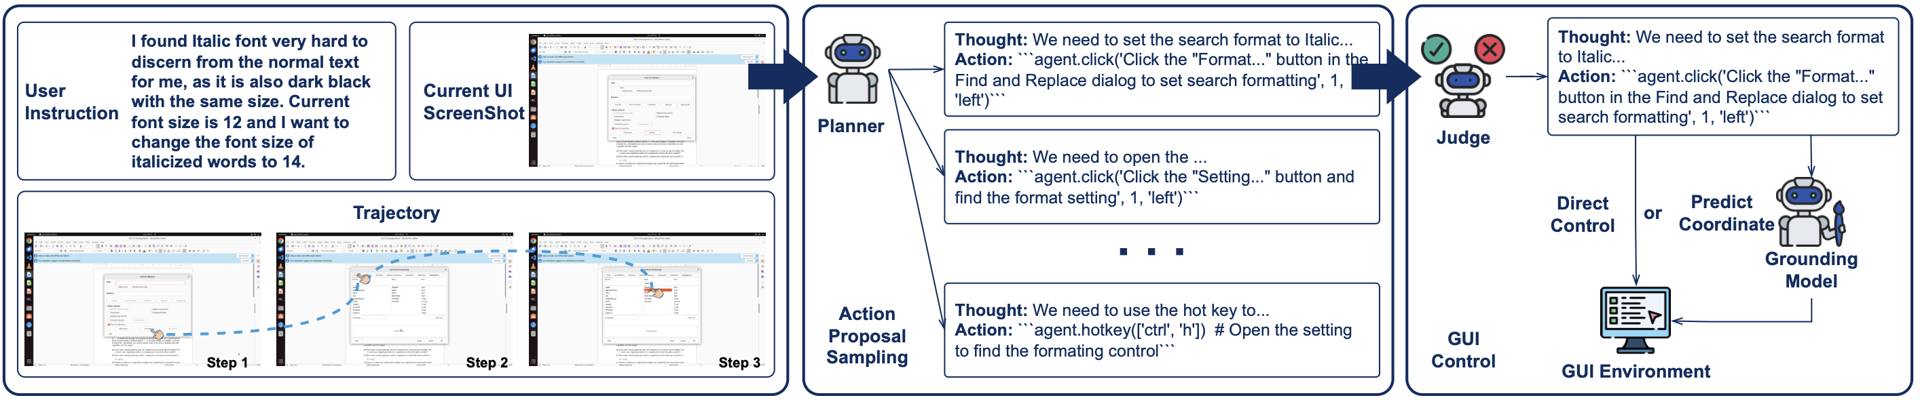
GTA1 - GUI Test-Time Scaling Agent
4/13
What is the core design of GTA1?
A planner proposes actions; a judge selects one; a grounding model maps coordinate actions to pixels.
Paper Fig. 2: planner samples candidate action proposals; judge selects; grounding model executes coordinate actions.
Coordinate-based actions, such as clicks, are sent to the grounding model.
Non-coordinate actions, such as hotkeys or typing, can be executed directly.
The loop repeats until task completion or termination.
Source: Yang et al., GTA1: GUI Test-Time Scaling Agent, ICLR 2026
Notes:
Use the figure as the main explanation: planner proposes, judge selects, grounding model converts coordinate actions to pixels.
Non-coordinate actions, such as typing or hotkeys, can be executed directly.
Coordinate actions go through the grounding model so the click is placed inside the intended UI element.
Emphasize the loop: after each action, the screen changes and the next decision is made from fresh evidence.
Transition: the first innovation is how planning is scaled at test time.

Slide 6
GTA1 - GUI Test-Time Scaling Agent
5/13
How does test-time scaling improve planning without lookahead?
It explores local alternatives at each step rather than rolling out full trajectories.
1. Sample K proposals
➜
2. Judge current fit
➜
3. Execute one action
Context = user instruction + past trajectory + current screenshot
The judge evaluates alignment with user intent and current GUI state.
Concurrency makes K proposals a compute-time tradeoff rather than a long sequential rollout.
This reduces overcommitment to a single weak action proposal.
Default in experiments: K = 8 action proposals per step.
Source: Yang et al., GTA1: GUI Test-Time Scaling Agent, ICLR 2026
Notes:
Cascade -> concurrency: Trading computational effort for a more stable and shorter task execution path
Use the figure as the main explanation: planner proposes, judge selects, grounding model converts coordinate actions to pixels.
Non-coordinate actions, such as typing or hotkeys, can be executed directly.
Coordinate actions go through the grounding model so the click is placed inside the intended UI element.
Emphasize the loop: after each action, the screen changes and the next decision is made from fresh evidence.
Transition: the first innovation is how planning is scaled at test time.

Slide 7
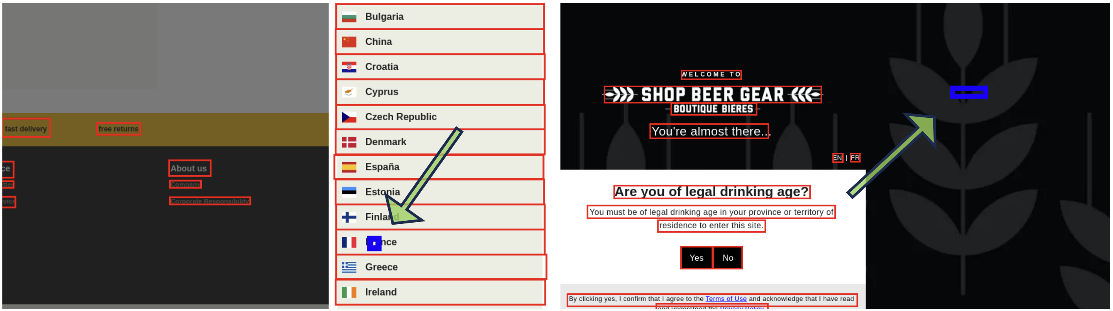
GTA1 - GUI Test-Time Scaling Agent
6/13
Why clean grounding data before RL training?
Click rewards need accurate target boxes; noisy boxes make correct clicks look wrong.
Use OmniParser to detect visible UI element boxes in each screenshot.
Compare the annotated box with detected boxes using maximum IoU.
Discard a sample when max IoU < τ; the paper uses τ = 0.3.
Paper Fig. 3: annotation boxes can be misaligned with the rendered UI; cleaning filters them out.
Resulting training signal:
“inside the actual UI element” instead of “match a potentially wrong center point.”
Source: Yang et al., GTA1: GUI Test-Time Scaling Agent, ICLR 2026
Notes:
Motivation: RL grounding needs reliable target boxes; noisy annotations make correct clicks look wrong.
GTA1 cleans the data by comparing annotated boxes with visible UI boxes detected by OmniParser.
If the best IoU is below the threshold τ = 0.3, the sample is filtered out.
The cleaned data makes the reward closer to the real target element rather than a mislabeled center point.
Transition: with cleaner boxes, the paper can define a click-based reward.

Slide 8
GTA1 - GUI Test-Time Scaling Agent
7/13
How is RL grounding aligned with real clicking?
The model is rewarded for predicting any valid click point inside the target element.
Input: screenshot s + action proposal p
Output: coordinate o = (x, y)
reward r = 1 if xmin ≤ x ≤ xmax and ymin ≤ y ≤ ymax; otherwise r = 0
GRPO samples N responses per input and normalizes binary rewards into advantages.
No mandatory chain-of-thought or bounding-box prediction is needed for static grounding.
The objective matches GUI interaction: clicking anywhere inside the target should succeed.
Source: Yang et al., GTA1: GUI Test-Time Scaling Agent, ICLR 2026
Notes:
IoU reward -> Click reward
Input is a screenshot plus an action proposal; output is a coordinate.
Reward is binary: 1 if the coordinate falls inside the target box, otherwise 0.
This directly matches GUI interaction because clicking anywhere inside the target element should work.
GRPO samples multiple coordinates and uses normalized rewards as advantages.
Emphasize that no extra chain-of-thought or bounding-box prediction is required for this static grounding task.
Transition: the ablation tests whether this simple reward is enough.

Slide 9
GTA1 - GUI Test-Time Scaling Agent
10/13
Which reward design works best for grounding?
Click-only reward is the simplest and strongest overall design in the paper’s ablation.
Ablation lesson
Bounding-box IoU reward adds extra prediction burden.
Format reward enforces reasoning syntax but does not improve static grounding.
Click reward directly matches the GUI success criterion.
ScreenSpot-Pro accuracy (%)
Source: Yang et al., GTA1: GUI Test-Time Scaling Agent, ICLR 2026
Notes:
Read the chart from left to right: click-only reaches the best ScreenSpot-Pro accuracy in this ablation.
Adding IoU reward asks the model to predict boxes, which is an extra burden for a click task.
Adding format reward enforces reasoning syntax, but does not improve this static grounding setting.
Takeaway: align the training objective with the actual success criterion—valid clicking.
Transition: now return to test-time scaling and its cost-performance trade-off.

Slide 10
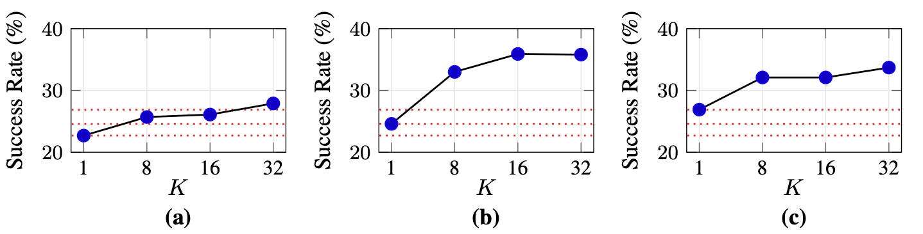
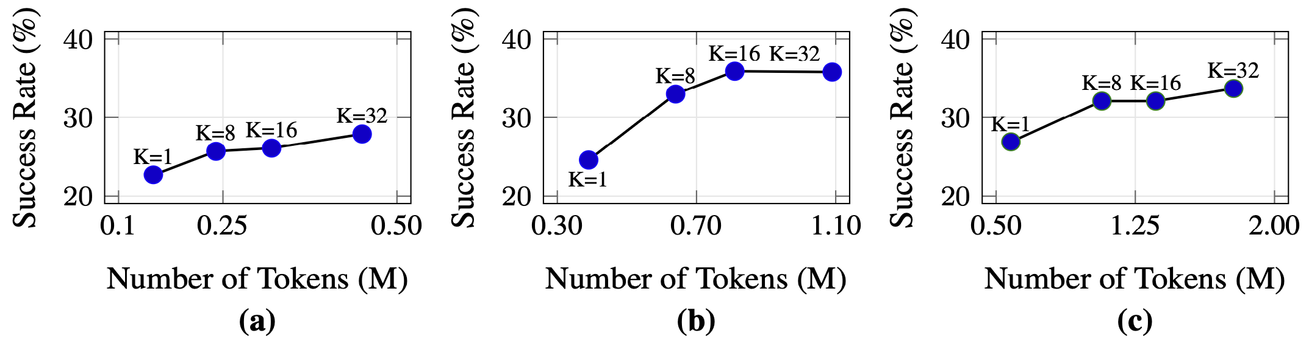
GTA1 - GUI Test-Time Scaling Agent
11/13
How far should test-time scaling go?
More candidate actions generally improve success, but token cost rises; the paper uses K = 8 by default.
Paper Fig. 4: success rate increases with more candidate proposals K across step horizons.
Paper Fig. 5: higher K consumes more tokens per task, creating a compute-performance tradeoff.
K = 1 is the no-scaling baseline.
K = 8/16/32 explores more local alternatives concurrently.
Best horizon is task-dependent: too few steps cannot finish; too many dilute the gain.
Source: Yang et al., GTA1: GUI Test-Time Scaling Agent, ICLR 2026
Notes:
sample K candidate action proposals
K controls how many candidate actions are sampled per step; K = 1 is the no-scaling baseline.
The figures show that increasing K generally improves success, especially when enough steps are allowed.
However, token usage also rises, so this is a compute-performance trade-off rather than a free gain.
K = 8 is used as a practical default in the experiments.
Transition: finish with the remaining failure modes and the final message.

Slide 11
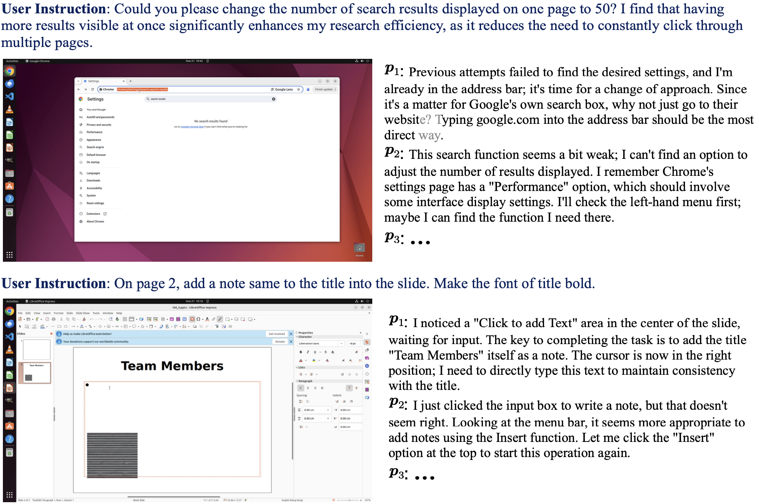
GTA1 - GUI Test-Time Scaling Agent
13/13
What still fails, and what should we remember?
GTA1 improves local decision quality, but a judge cannot select a correct action if none of the proposals are valid.
Main contribution:
test-time scaling for planning + click-reward RL for grounding.
Key result:
strong grounding and task-execution gains with a modular two-stage agent.
Main limitation:
proposal quality and task feasibility still bound the entire system.
Takeaway:
robust GUI agents need both
better “what to do next” selection and
better “where to act” grounding.
Paper Fig. 7: failure cases occur when every sampled proposal is wrong or the task is infeasible.
Source: Yang et al., GTA1: GUI Test-Time Scaling Agent, ICLR 2026
Notes:
Smarter choice + more aligned clicking
Summarize the contribution in one sentence: GTA1 improves planning through test-time candidate selection and improves grounding through click-reward RL.
State the boundary clearly: the judge can only choose among sampled proposals; if all candidates are wrong, selection cannot fix the step.
Task infeasibility or bad environment state can also cause failure.
Final takeaway: reliable GUI agents need both smarter “what to do next” decisions and more aligned “where to act” grounding.
End by connecting GTA1 to the broader theme of inference-time scaling for agents.

